Slide 1
Functional Programming Python + Functional Programming = ?
Markos Vassilis, Mediterranean College
Week 16

Slide 2
A Quick Python Revision

Slide 3
Data Types in Python
Name a few known data types (primitive or not):
character
string
integer
float (double etc)
object
…
What about those in Python?
Python is not a typed language, which means that you should not declare types while writing code. Everything is done by python under the hood.
Everything in this course refers to Python 3, which we simply refer to as “Python”.

Slide 4
Bits of Python #001
What will the following piece of code print? a = 1 a = ‘a’ a = 2.4 print(type(a) == type(1))
This will print False because the variable a ended up being a float, hence its type is not the same as that of 1, which is of type int.

Slide 5
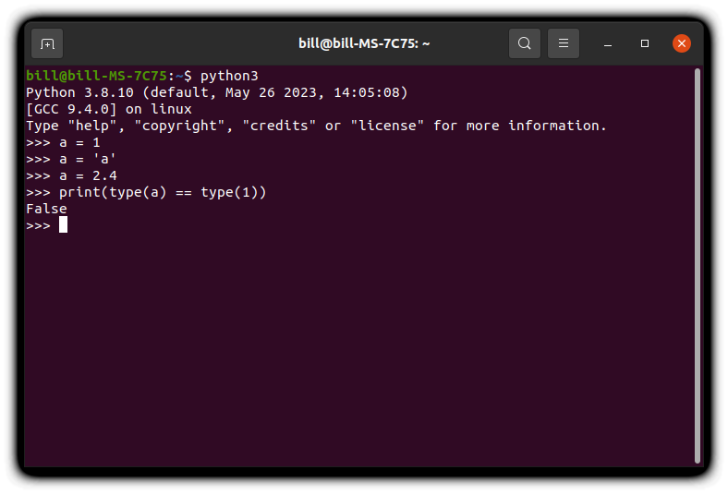
Bits of Python #001

Slide 6
Bits of Python #002
What will the following piece of code print? a = [3, 5, 2, 4] b = [3, 5, 2, 4] x = a.sort() == sorted(b) print(x)
It will print False, because object.sort() returns None (it is an object method) while sorted(list) returns a new sorted list.

Slide 7
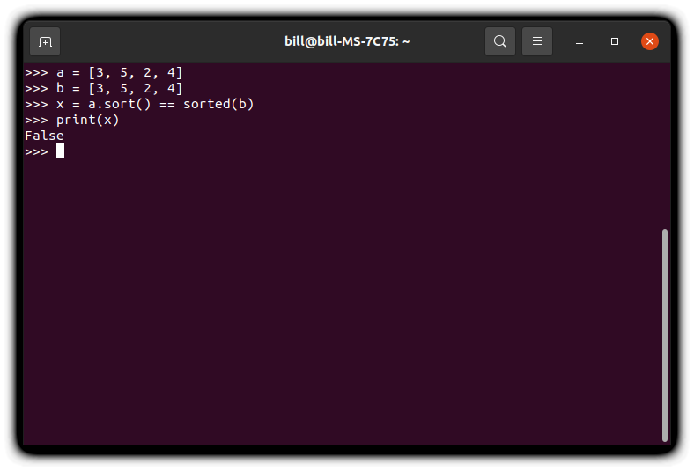
Bits of Python #002

Slide 8
Bits of Python #003
What will the following piece of code print? a = ‘qwerty’ b = a[2:-1] c = a + b * 2 print(c)
It will print qwertyertert as a[2:-1] yields the substring of a starting from its third character (inclusive) up to its last character (exclusive) and multiplying a string by an integer n repeats that string n times.

Slide 9
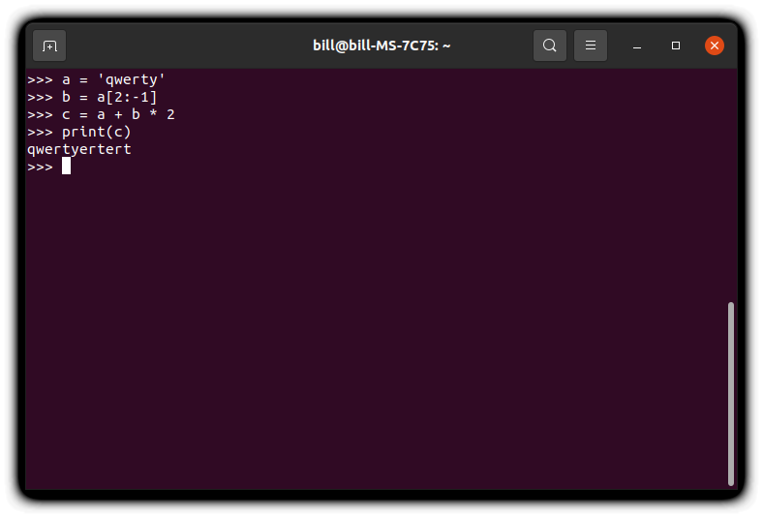
Bits of Python #003

Slide 10
Bits of Python #004
What will the following piece of code print? a = [10, 24] c = 0 while a: x = a.pop() if x % 2 == 0: a.append(x // 2) c += 1 print(c)
It will print 4, since c is incremented only whenever x is a multiple of 2, which is the case for exactly 4 cases (24, 12, 6, 10).

Slide 11
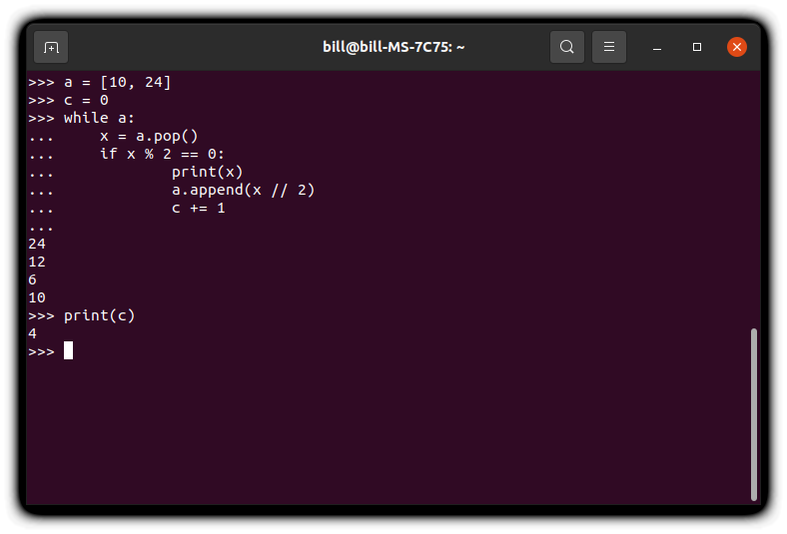
Bits of Python #004

Slide 12
Bits of Python #005
What will the following piece of code print? def foo(x): a = [] for i in range(2, x ** 2, 3): a.append(3 * x ** 3) return len(a) print(foo(5) + foo(6))
It will print 20, since the first loop (foo(5)) runs for i = 2, 5,..., 23 (8 times) and the second loop (foo(6)) for i = 2, 5,..., 35 (12 times).

Slide 13
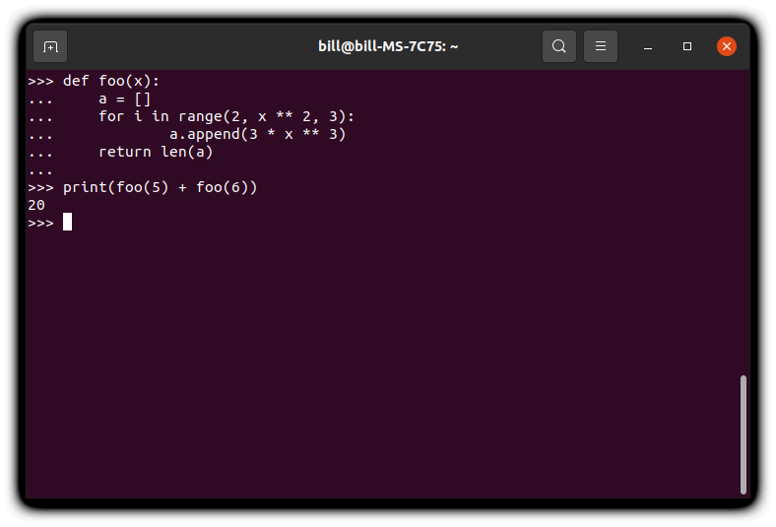
Bits of Python #005

Slide 14
Printing files in Python
Consider the following piece of code:
f = open('test.txt', 'w') f.write('asda') f.close() g = open('test.txt', 'r') a = [print(x) for x in g]
The above snippet creates a file named test.txt and writes ‘asda’ in it. Then, it opens the file and prints its content.
Execute it to verify its functionality!

Slide 15
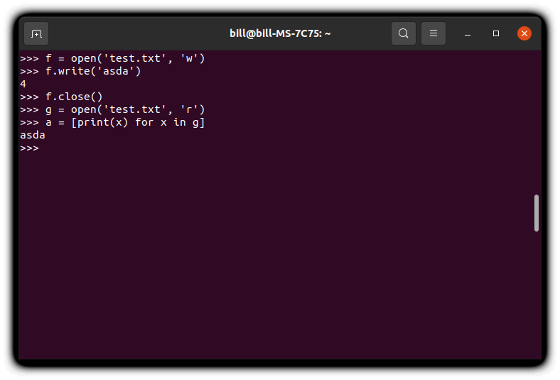
Example Execution

Slide 16
Forgetting to close files *with* Python…
It is usual to forget to close files when reading / parsing / editing them, leading to unexpected behaviour (e.g., damaged files, improper initialisation etc)...
…but Python can take care of that, as well!
with open('test.txt', 'w') as f: f.write('asda') with open('test.txt', 'r') as g: a = [print(x) for x in g]
The above snippet achieves exactly the same as above, without having us worry about closing file (streams) or whatnot.
Execute it to verify its functionality!

Slide 17
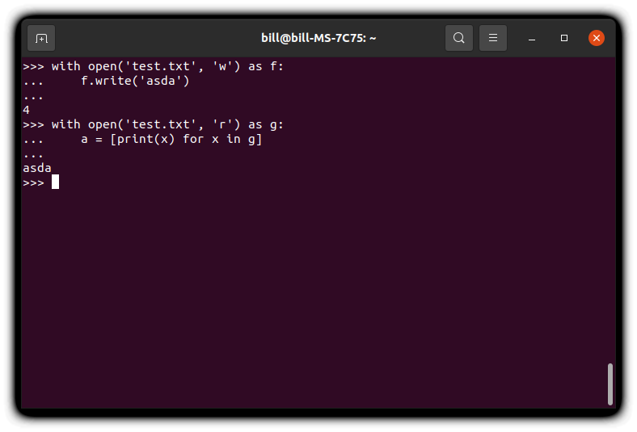
It Really Works!

Slide 18
Functional Programming + Python

Slide 19
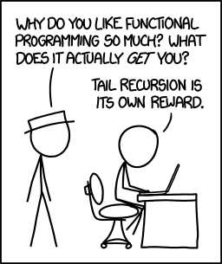
Some Programmer’s Humour First
This course’s goal is to understand programming so deeply that you actually consider this funny: Source: https://xkcd.com/1270/

Slide 20
Going First Class
In Haskell, functions are everywhere!
This is because they are first class objects, so one can:
assign them to variables;
pass them as arguments;
treat them just like any other variable.
The same is also true for Python:
So, to that end, you can let the warmth of Haskell flood your mind.
This instantly allows us to define higher order functions and play around with more advanced functional programming stuff!

Slide 21
Python’s Functional Toolkit
itertools: This module implements a number of iterator building blocks inspired by constructs from APL, Haskell, and SML.
Each has been recast in a form suitable for Python.
functools: The functools module is for higher-order functions: functions that act on or return other functions.
In general, any callable object can be treated as a function for the purposes of this module.
There are also some built–in elements of the language such as comprehensions that are of a functional nature and might come in handy.

Slide 22
filter(function, iterable)
Much like in Haskell, it accepts:
a boolean function, which is used to filter the contents of an;
iterable, keeping only those for which the function evaluates to True.
For instance, how would you keep all even numbers from a list of integers?
even = lambda ns: filter(lambda n: n % 2 == 0, ns)
Run this!
What did you get?
Something like: <filter object at 0x00000140E69ED3F0>.
How to fix that?
Wrap it using list()!

Slide 23
map(function, iterable)
Much like in Haskell, it accepts:
a boolean function, which is used to map the contents of an;
iterable, until it is exhausted.
For instance, how would you double all numbers from a list of integers?
double = lambda ns: map(lambda n: n * 2, ns)
Run this!
What did you get?
Fix that, maybe?

Slide 24
Fun Time!

Slide 25
Pythonic Folding
In Haskell, folding has proved to be a really cool and useful feature of the language, but, what about python?
Follow the lab below to find out more about the pythonic way of folding:
https://realpython.com/python-reduce-function/

Slide 26
Do You Read Books?
Regardless of that, please follow the instructions found at:
./labs/books_lab_01.pdf

Slide 27
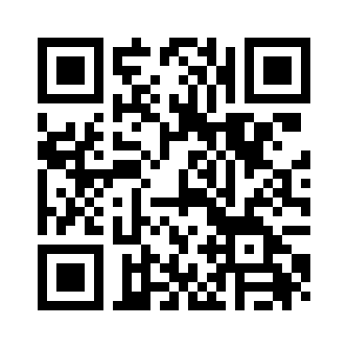
Any Questions
Don’t forget to fill in the questionnaire shown right!
https://forms.gle/YU1mjxjBjBf8hyvH7

